Slide 1
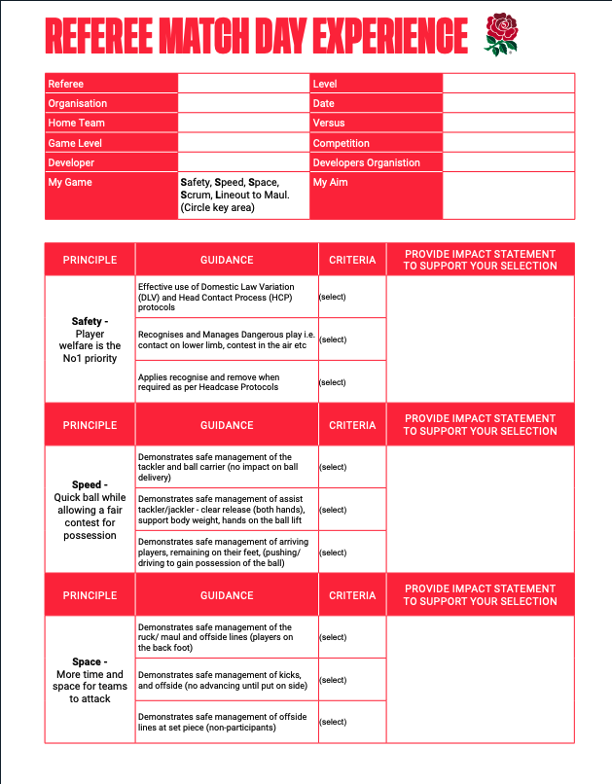

Referee Match Day Experience
Form [RMDE]
Process

Slide 2
Agenda
RMDE Context & Guidance
Process
  Pre-Match (Referee Work-Ons)
  Post-Match (Adviser Report/Referee Review)
  Report Finalisation
Questions

Slide 3
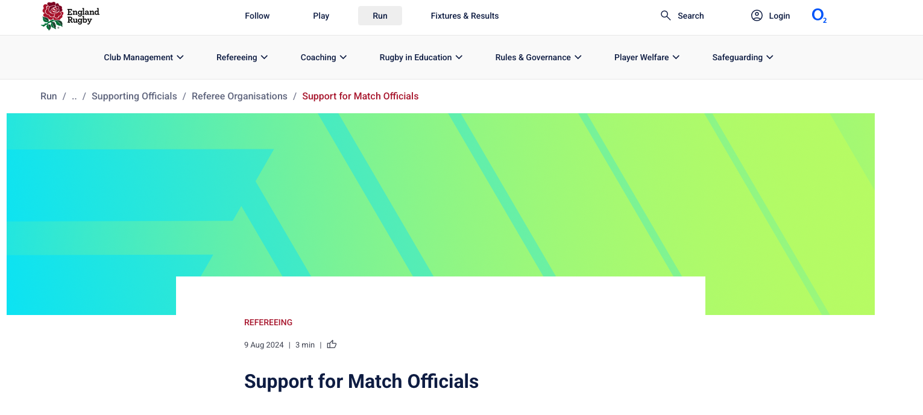
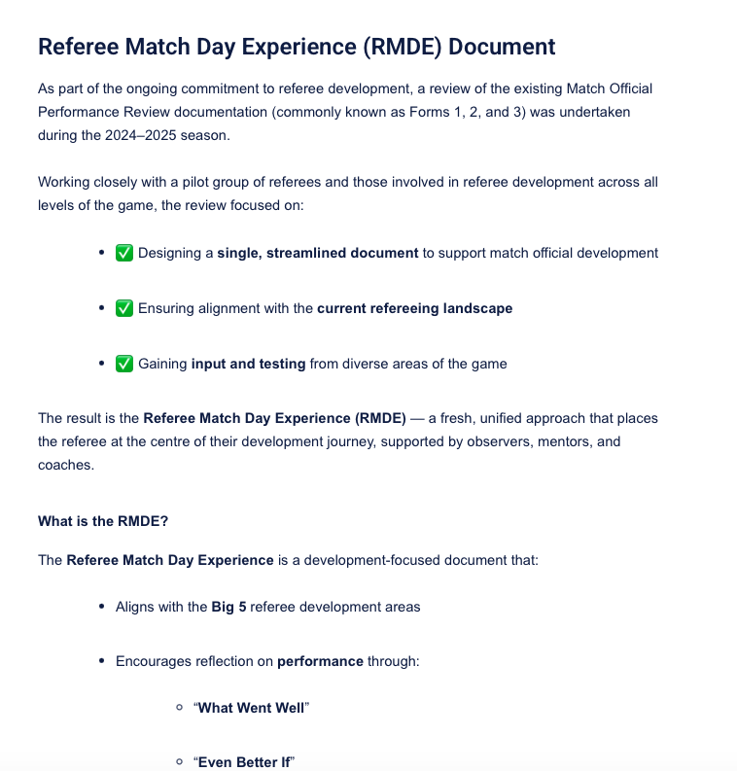
Context & Guidance
RMDE introduced nationally from January 2026 to replace previous Forms 1,2 & 3
All operated via WhosTheRef (WTR)
England Rugby/RFU - Support for Match Officials
  RMDE Report Document - blank RMDE Form
  RMDE Guidance Document - instructions
  Big 5 Guide
RFU Referees – Facebook Page (videos)
KSRFUR Guidance – issued 12th January 2026

Slide 4
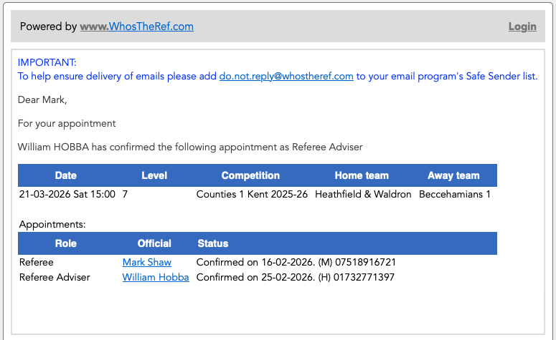

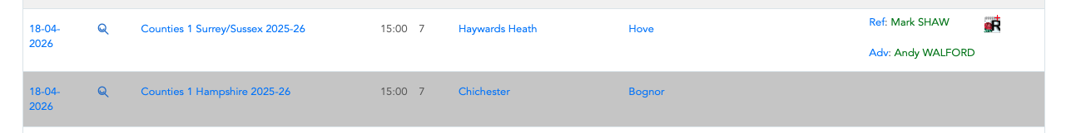
Pre-Match
APPOINTMENT
You get your appointment & confirmation of a MOD/Assessor/Adviser/Coach
If looking at the Fixtures or Reports view in WTR –
DO NOT CLICK on the report+ icon shown ahead of/after the game – this is for self assessment and only visible to you

Slide 5
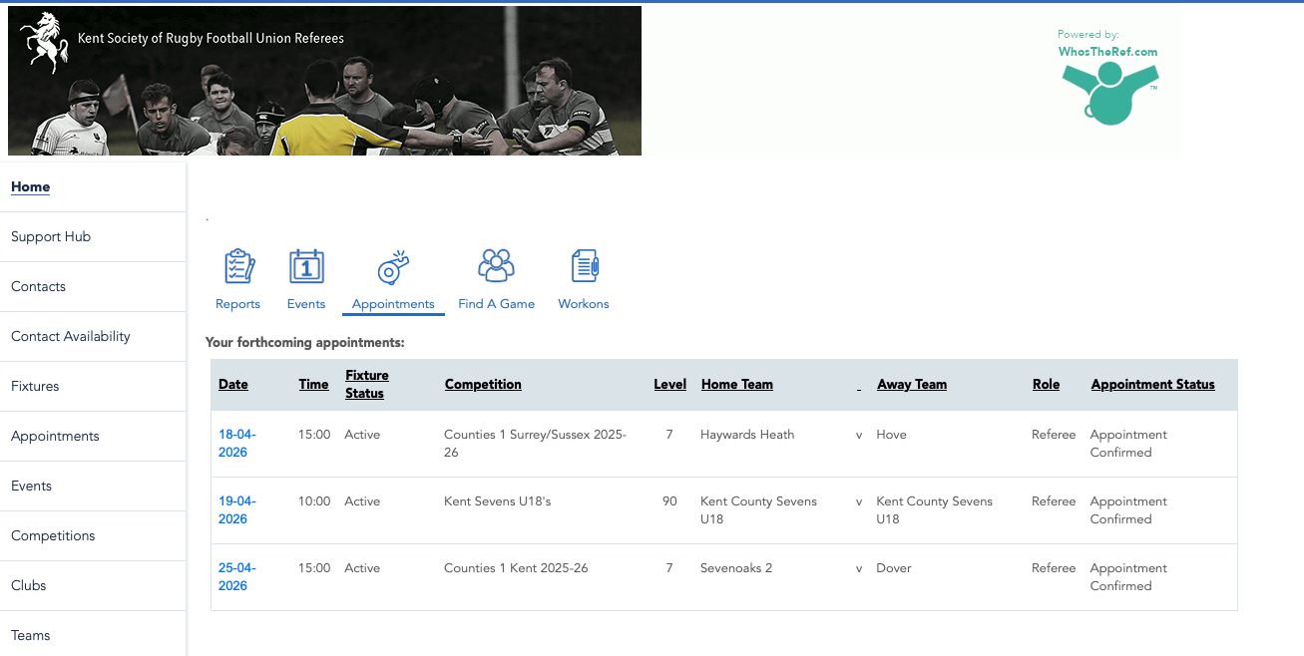
Pre-Match
WORK-ONS (1)
In the week ahead of the game, make contact with your assessor and complete your “Work-Ons” for the game in WTR
  Go to the Home screen on WTR
  Click on the “Workons” icon

Slide 6
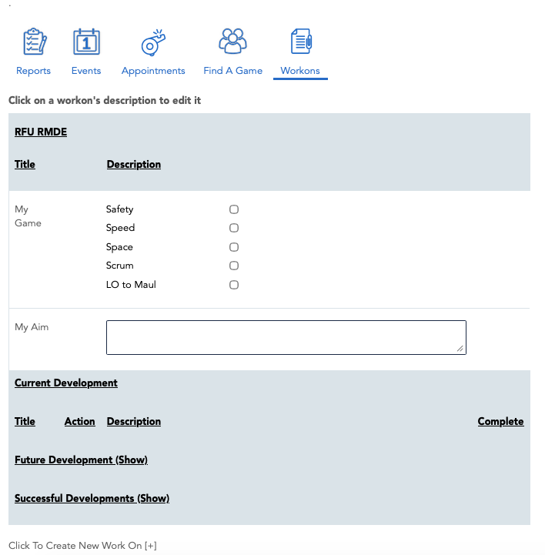
Pre-Match
WORK-ONS (2)
3 sections to complete
My Game – pick 2-3 areas from the Big 5
My Aim – free text on overall/current development objectives
Work-Ons – specific focus areas for this game
1
2
3

Slide 7
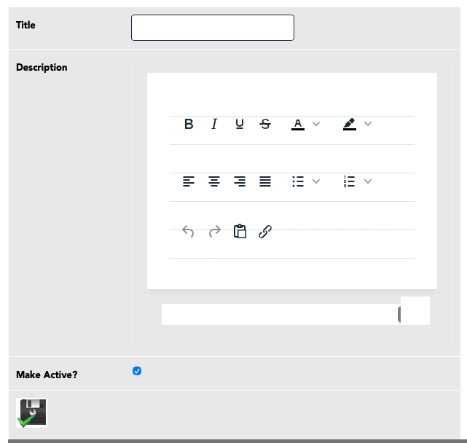
Pre-Match
WORK-ONS (3)
Completing your work-ons requires a title & free text description
Maximum of THREE (3) work-ons
Work-ons can be marked as ‘complete’ or be deferred for the future
Note: - the presentation and formatting of this box is still buggy – WTR are working on it
Things to try :
starting the process again from the main work-ons page
refreshing the page
different browser

Slide 8
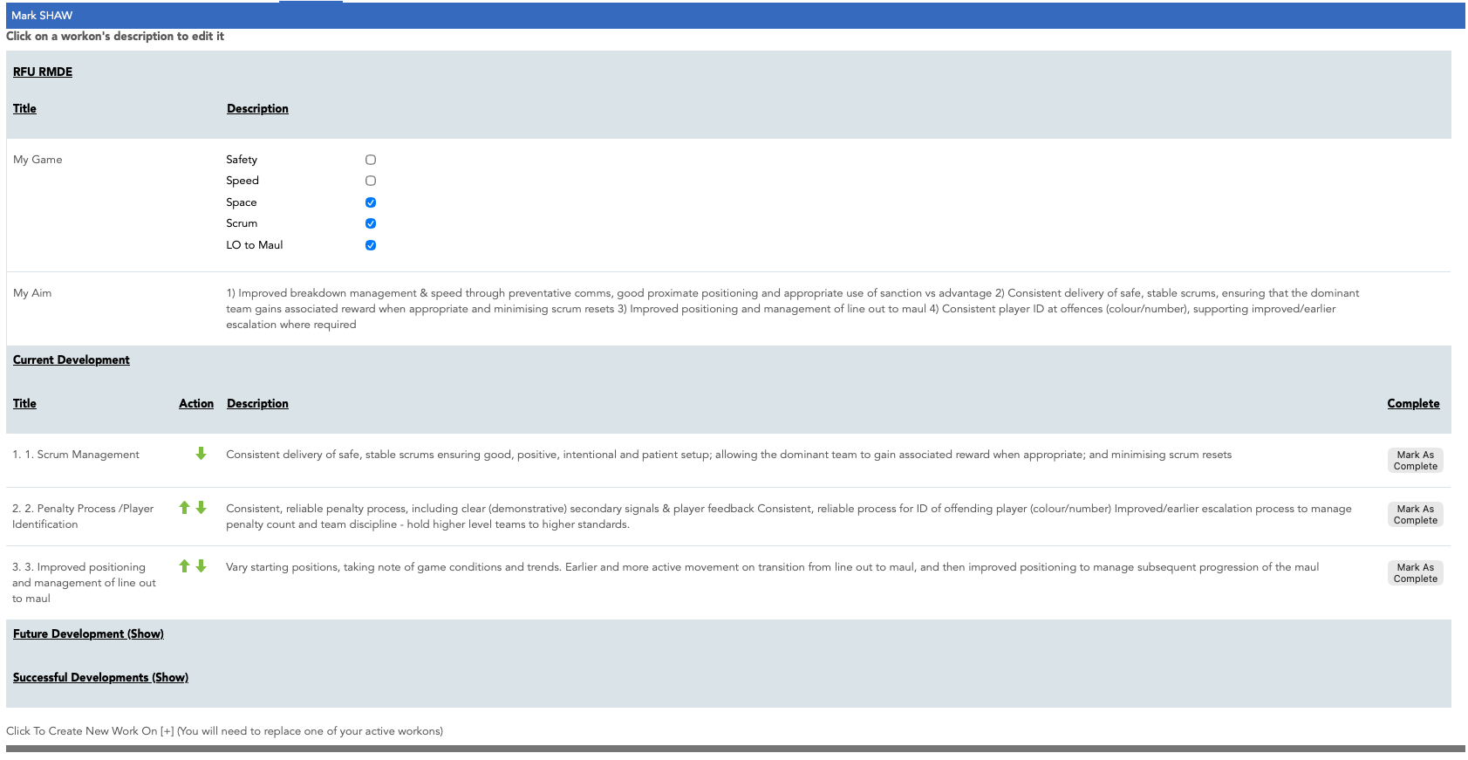
Pre-Match
WORK-ONS (4)
Completed Example:

Slide 9
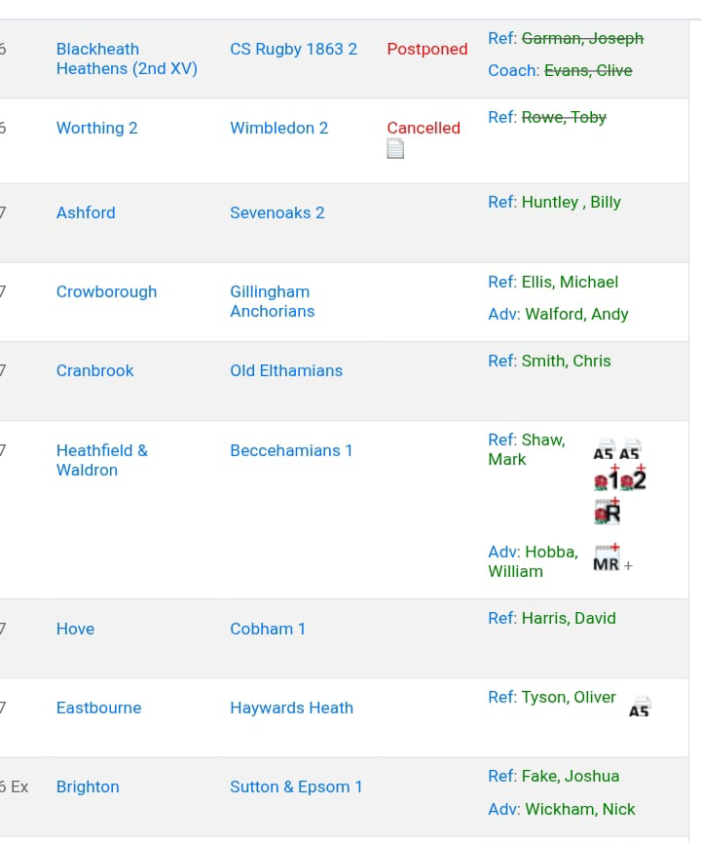
Post-Match
ADVISER REPORT (1)
After the game, the advisers will initiate the report from WTR, by clicking on the R+ match report icon
(Note: Forms1 & 2 still available for coaches)

Slide 10
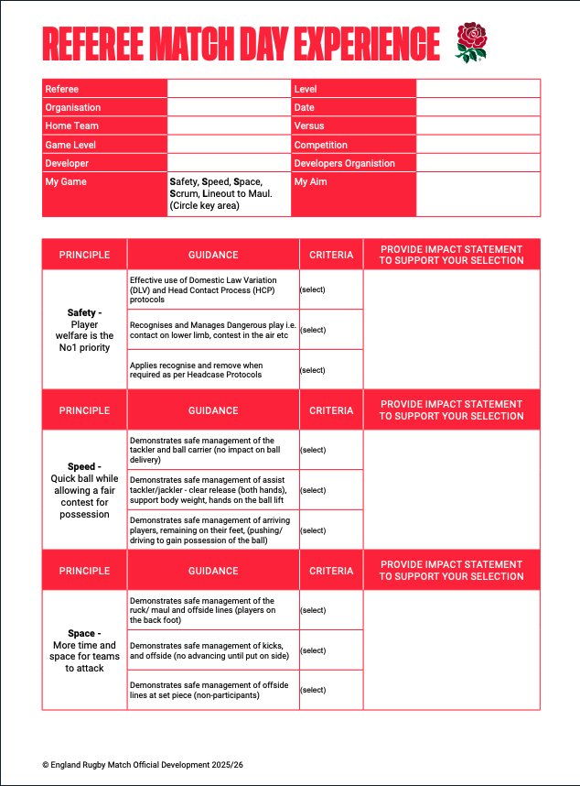
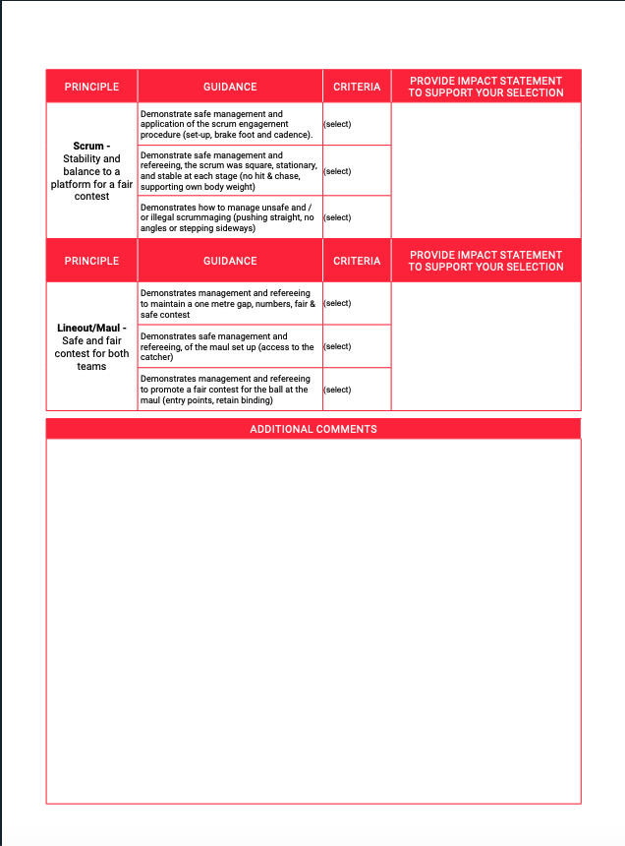
Post-Match
ADVISER REPORT (2)
Automatically Populated from Referee Work-Ons
Completed by Referee Adviser/MOD

Slide 11
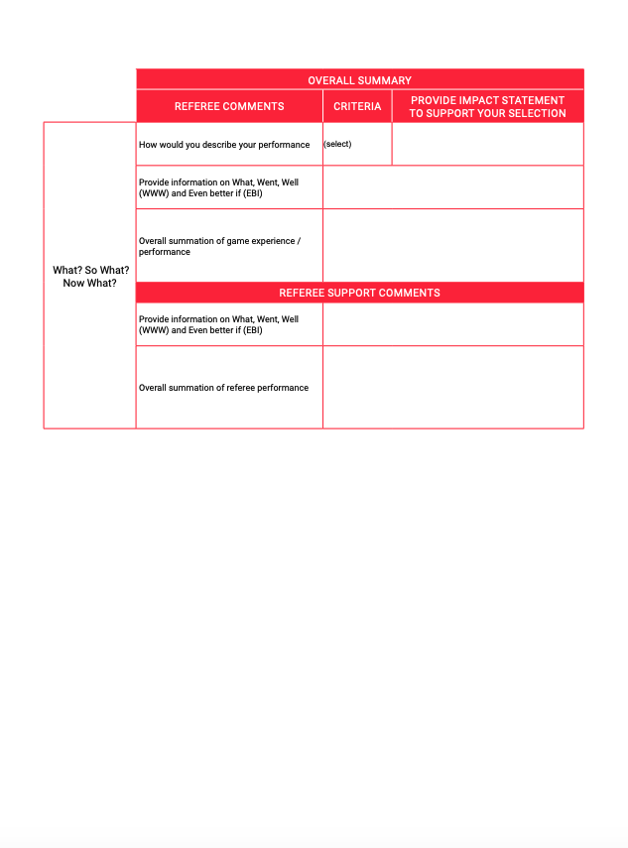
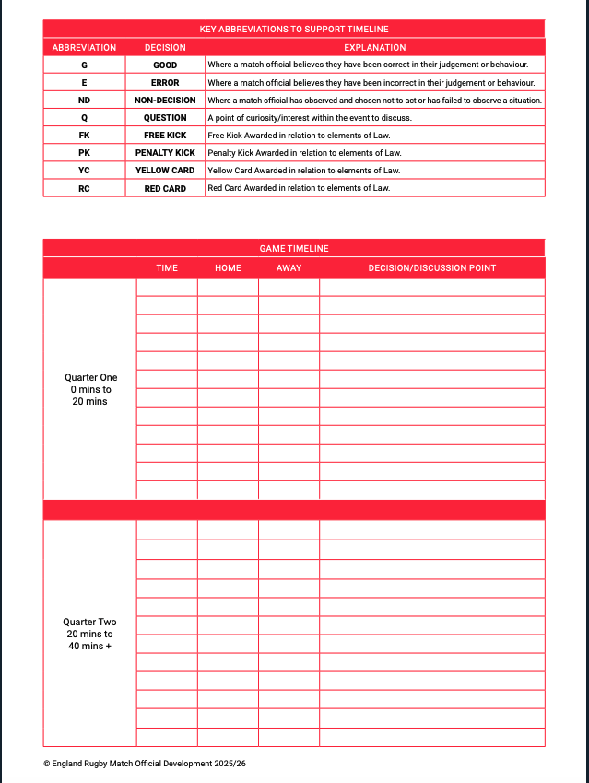
Post-Match
ADVISER REPORT (3)
Completed by Referee Adviser/MOD
Click “Save” Regularly to avoid losing work in progress

Slide 12
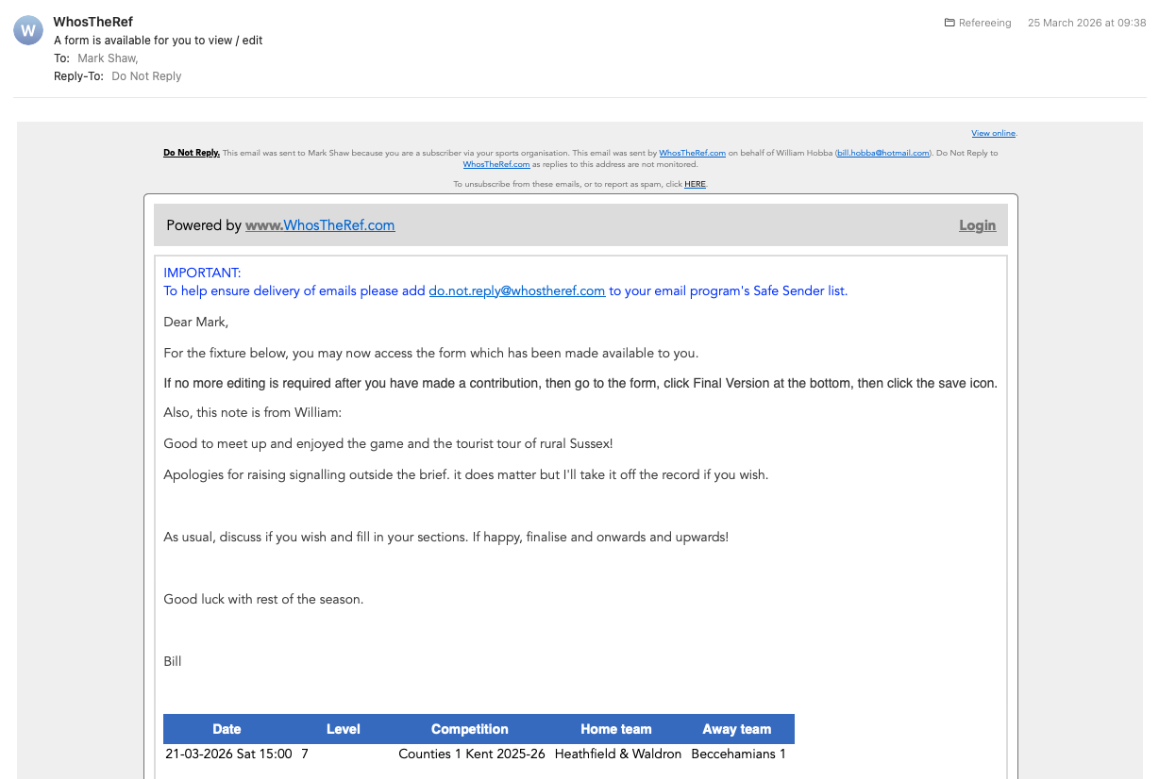
Post-Match
REFEREE NOTIFICATION
+ COMMENTS
Once the draft report is completed by the adviser, referee will be notified by WTR email, with optional covering note from the adviser
Completed by Referee
Click “Save” Regularly to avoid losing work in progress
When complete, click “Final Version” checkbox to return the report to the Adviser

Slide 13
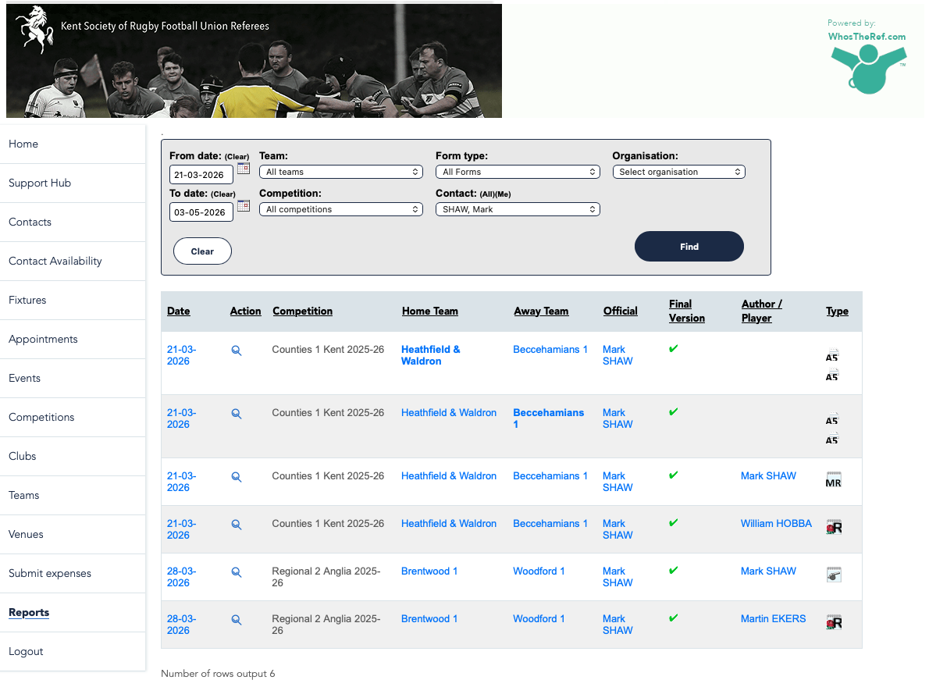
Post-Match
FINAL REPORT
Adviser finalizes report → Referee notified by email → Report available in WTR

Slide 14
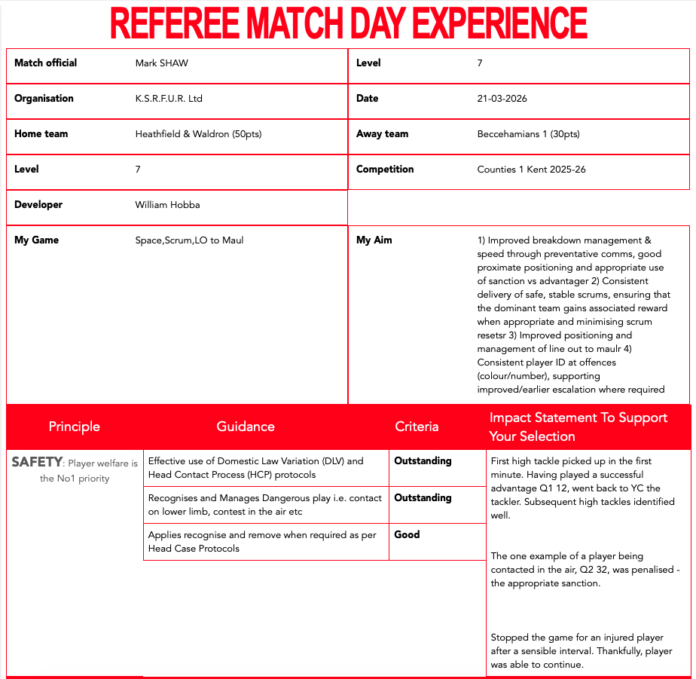
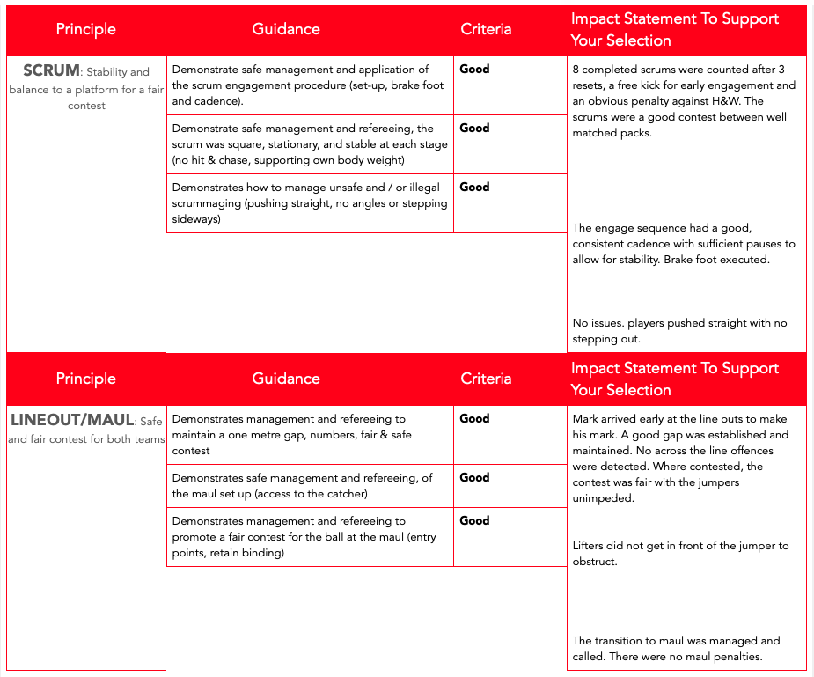
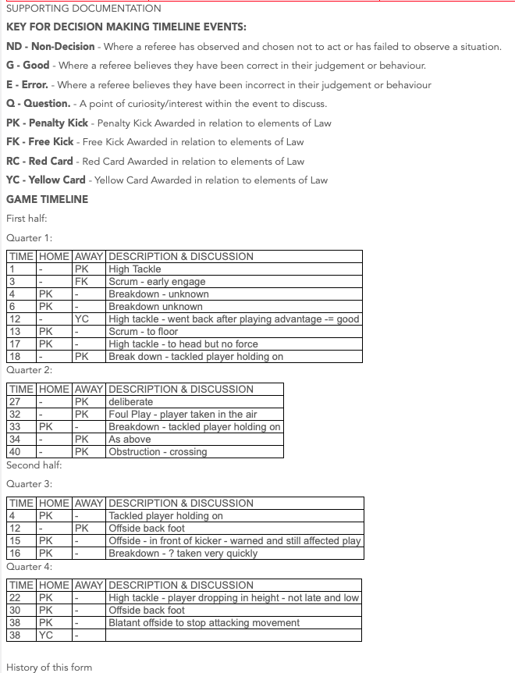
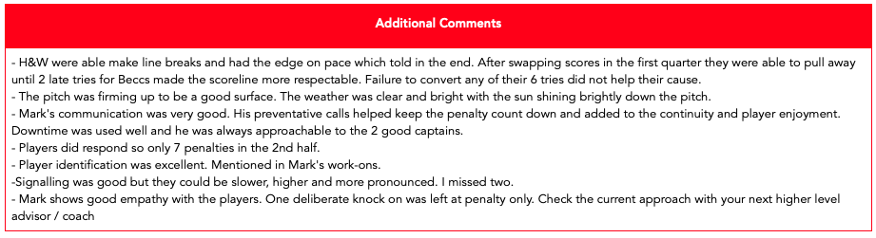
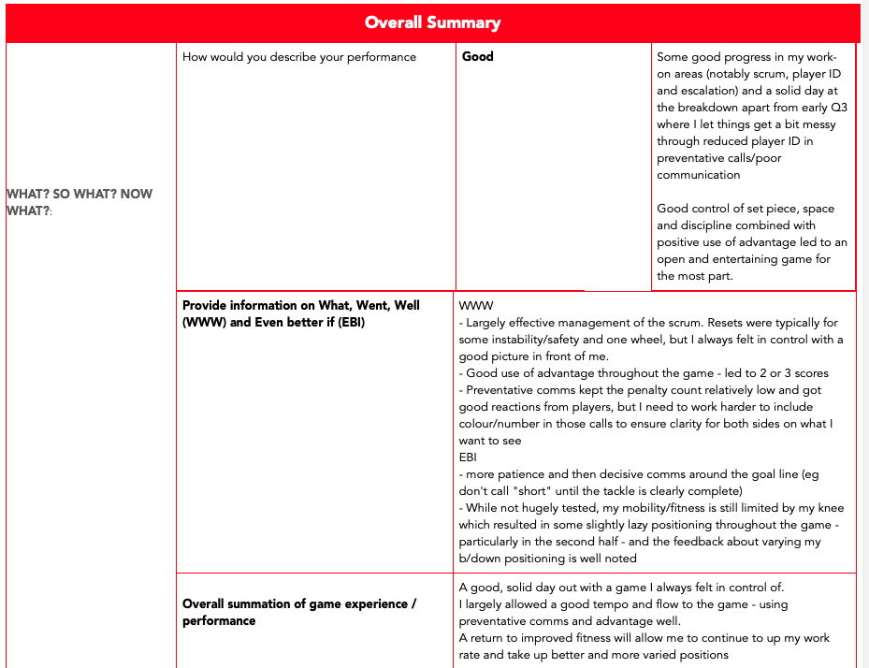
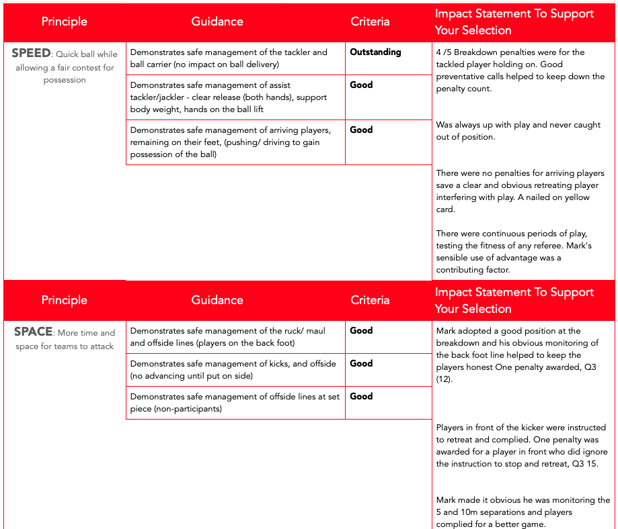
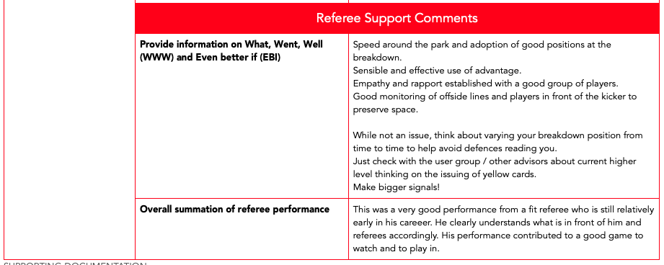
Post-Match
FINAL
REPORT

Slide 15

Questions

